Slide 1

Team Number: 16 - Hotel Management Application
Batch: 2YB
Members:
Hiral Visaria 2022SP93068
Kanishka Vats 2022SP93072
This presentation introduces our project on a hotel management application, showcasing the features and challenges we encountered.

Slide 2
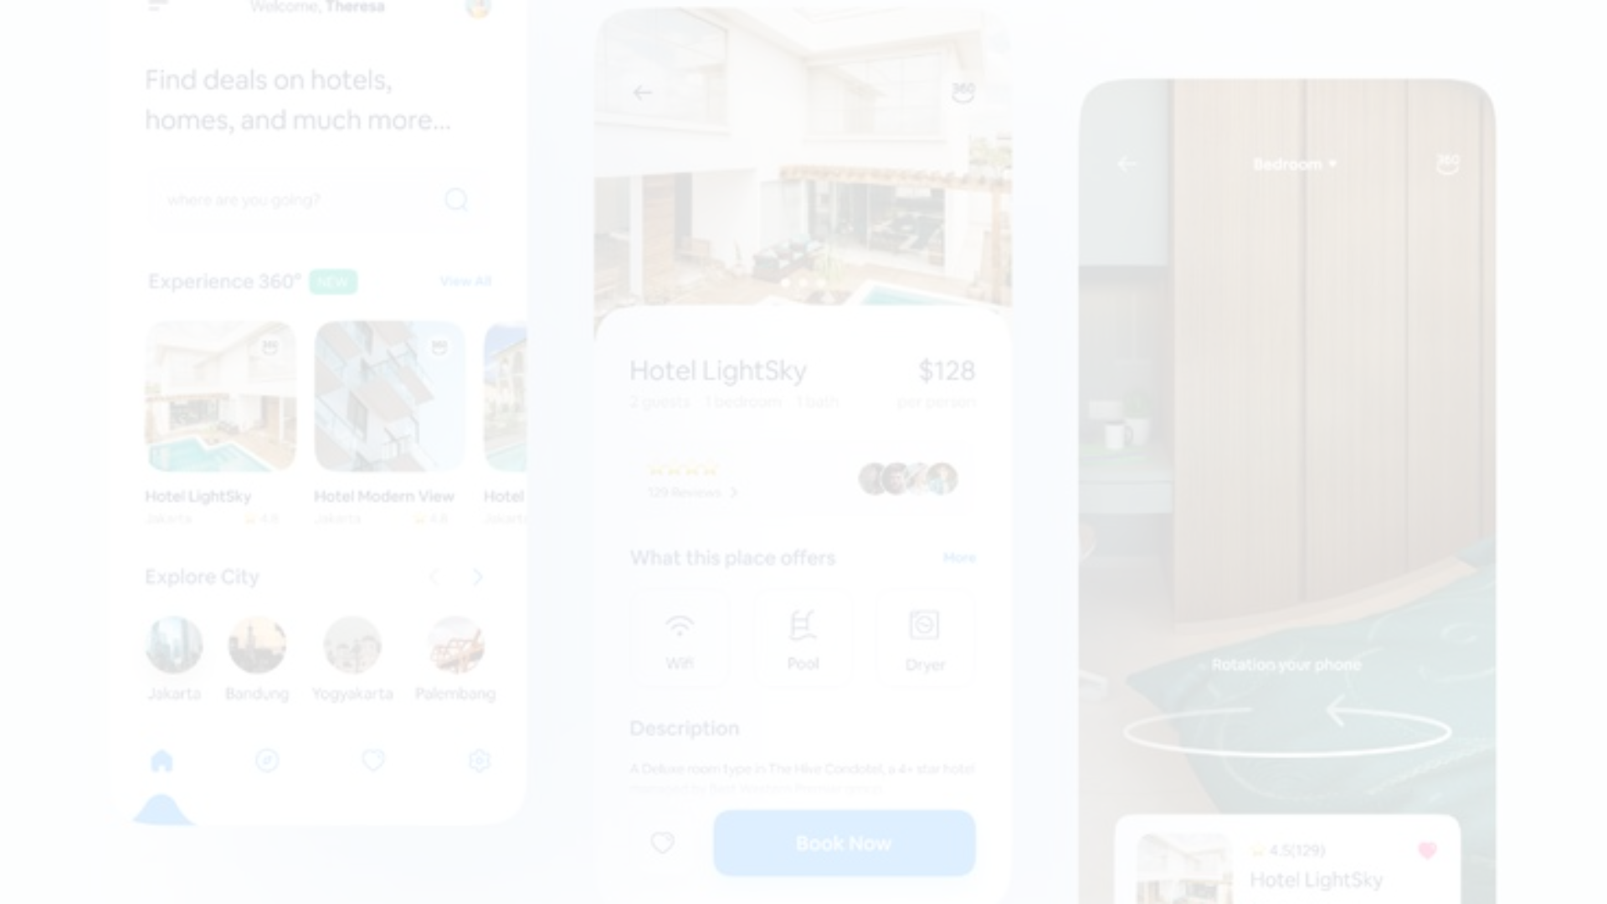
Project Overview
1
Login and Register
2
Booking & Map
3
Sorting & Management
Users can securely log in and register for the application.
Explore and book rooms across various destinations with interactive maps.
Effortlessly manage existing bookings and sort properties according to cost.
4
Map View
5
Saved Places
You can see the properties on the Map View.
Users can mark their favorite palces and later look into it.

Slide 3
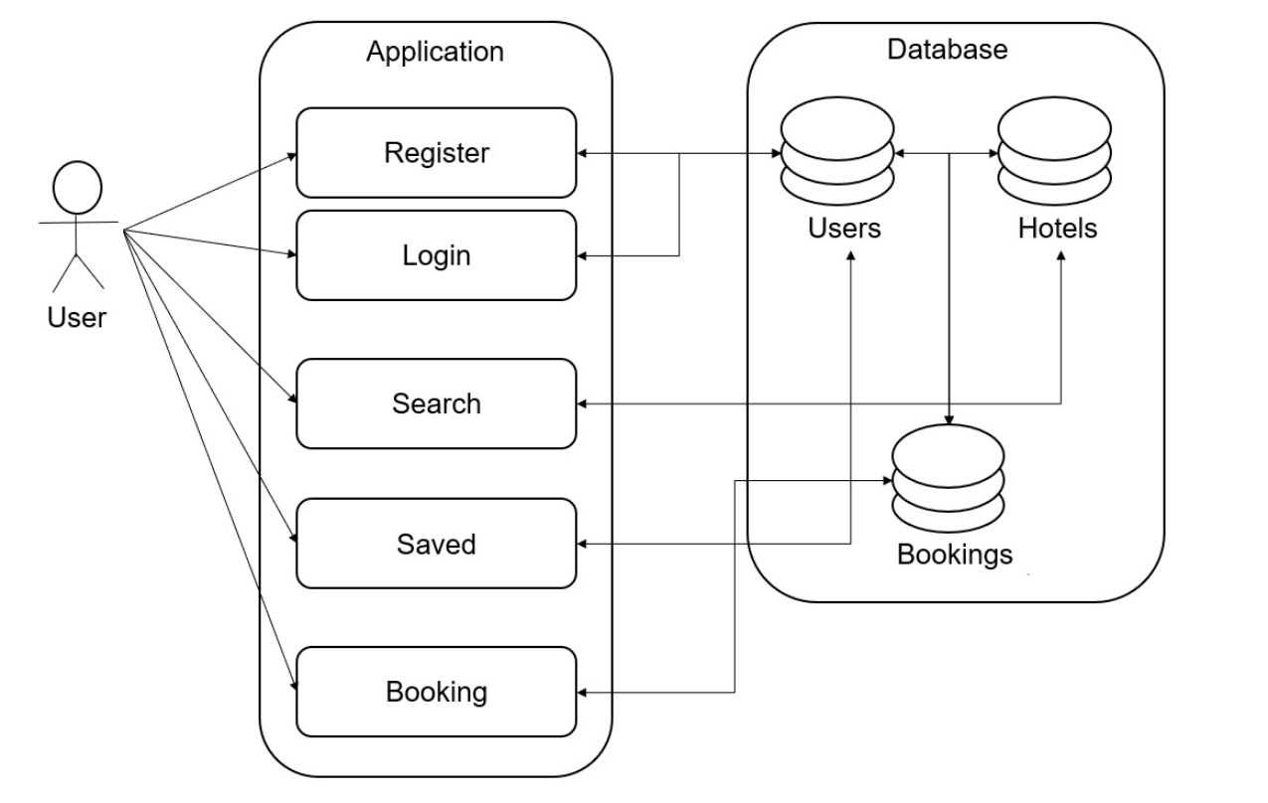
Architecture & Design

Slide 4
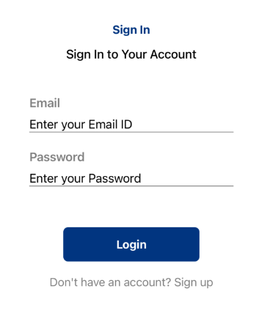
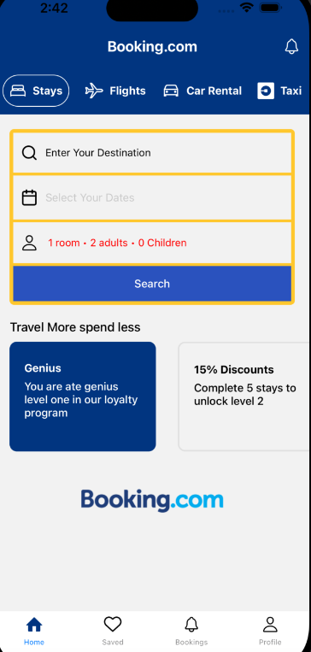
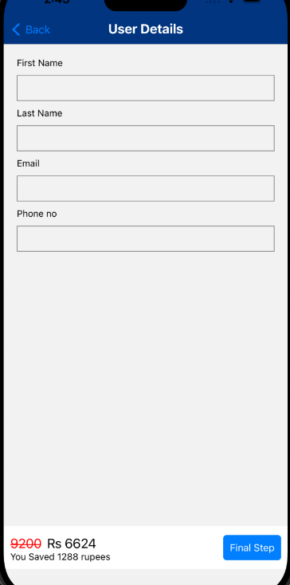
Application Screenshots

Slide 5
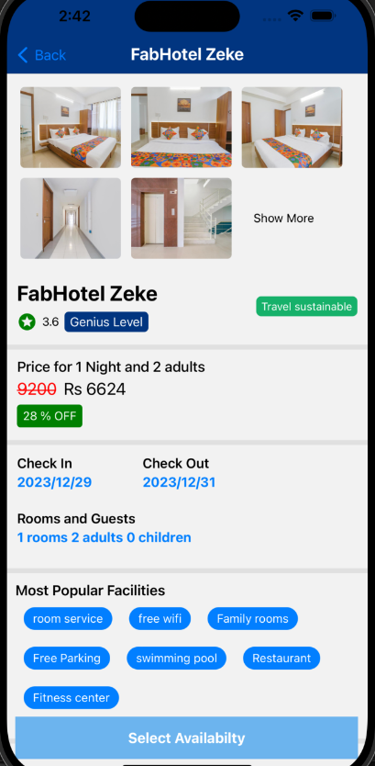
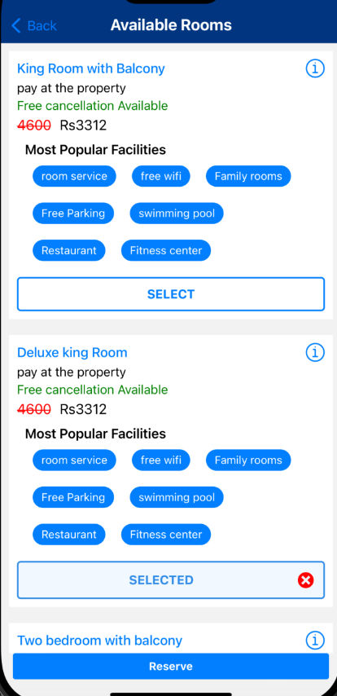
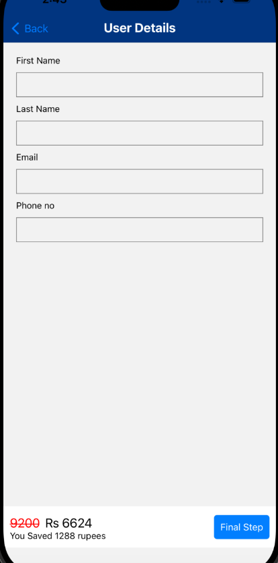

Slide 6


Challenges & Learnings
React Native Learning
Mac Setup
Overcoming the challenge of learning React Native within a short time frame.
Navigating the setup process on Mac for the development environment.

Slide 7

Project Highlights
Interactive Features
Deliver a user-centric experience through interactive elements and intuitive design.
Efficient Data Management
Ensure efficient data storage and retrieval using Firestore.
Seamless User Experience
Focus on providing a seamless and hassle-free experience for users.

Slide 8
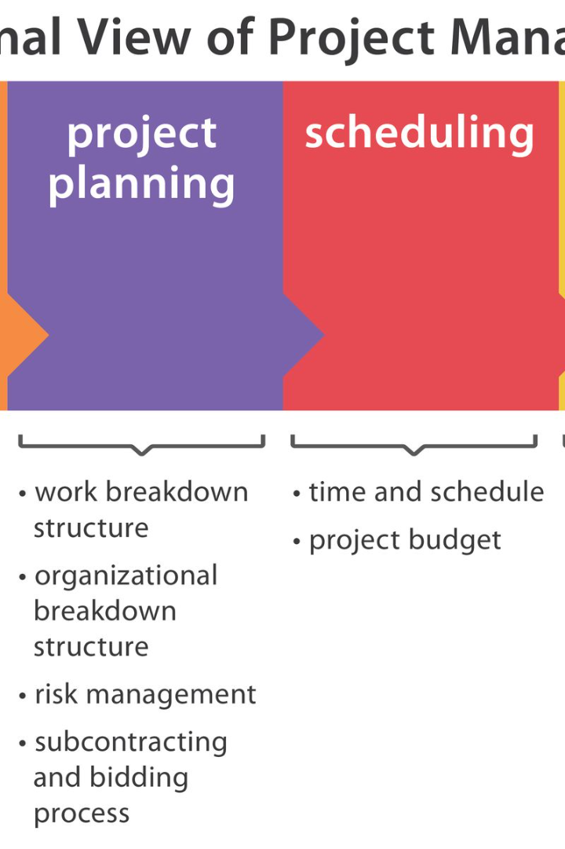
Thank You

